Slide 1
Data Acquisition Prototype:
Project & System Requirements
Phoenix
Ambulatory Blood Pressure Monitoring System
© 2008 Christopher J. Adams
Copying and distribution of this document is permitted in any medium, provided this notice is preserved

Slide 2
Agenda
Project Vision
System Vision & Scope (Business Requirements)
User Requirements
  Use Cases
  Business Rules (Algorithms)
System Requirements
  Functional Requirements
  Major Nonfunctional Requirements
Requirements Work Outstanding

Slide 3
Project Vision
Acquire community knowledge about
  Data acquisition devices
  Hardware and software co-design
  Partitioning systems into subsystems
  Allocating system requirements to subsystems
  Embedded software architecture options
  (round robin, round robin w/ interrupts, …, RTOS)
  Hardware options
  (MP, memory, gates, buses, ports, clocks, …)
  Acquiring hardware components
  Testing embedded software
Document results so they can be reproduced

Slide 4
Project Vision
Architecture — basic technology
  Hardware architecture
  Hardware component selection
  Embedded software architecture
  Software language selection
  Cross-platform development tools
Prototype
  Learning is primary
  Willing to abandon device based on lessons learned
Acquired data may be simulated

Slide 5
System Vision
Data acquisition device
  Collects analog signals from two piezoelectric film sensors
    Measurement Specialties SDT1-028K
  Converts analog signals to digital signals
  Collects signals from
Embedded analytics
  Calculates [BP | Heart Rate | Blood Flow | easiest measurement to calculate]
Embedded data storage
  Timestamps each acquired & calculated value
  Preserves acquired values beat-to-beat
  Preserves calculated values (how often?)
  Preserves up to (how many hours/days?) of data
Device allows ambulation during use
  At least carriable
Electrically self-contained
  Does not rely on external power source

Slide 6
System Vision
Major Out-of-Scope Capabilities
Capacity for 7 days of data
Device calibration
Patient alerts
Localization outside of U.S.

Slide 7
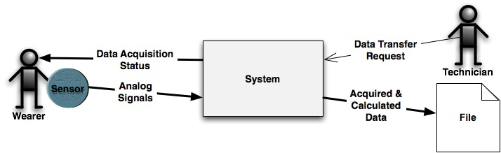
System Context

Slide 8
Use Cases
Technician connects device to Wearer
Wearer starts data collection
Wearer confirms device is working
Wearer signals the device to log an event
  Assures data acquisition logic despite sensor failure
Technician downloads data to a file

Slide 9
Business Rules
Algorithms
BP | Heart Rate | Blood Flow?

Slide 10
Functional Requirements
Downloaded Data
  ::=
    Head
      Device ID
      ( Absolute base time )
      Timestamp of download initiation
    Body
      { Acquired/calculated Item }*
        Sensor ID/Data Source ID
        Timestamp of acquisition/calculation
        Information type
        Value
    Tail
      Timestamp of download completion
      End of data marker
  If timestamps are relative
    then download must include absolute base time

Slide 11
Functional Requirements
Acquired/calculated information type
  Acquisition control event
    Start device
    Stop device
    Start acquisition
    Stop acquisition
  Wearer event
  Acquired mV
  Analytic

Slide 12
Major Nonfunctional Requirements
Interfaces
  Outgoing
    Downloaded data is well-formed XML
  Physical Connectors
    Device downloads data via a USB device
Physical Constraints
  Wearer wears or carries device during operation

